Slide 1
Protein Synthesis and Transport

Slide 2
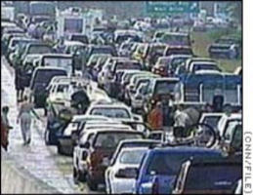
Protein Problems & Human Diseases
Diabetes
Alzheimer’s
Juvenile Parkinsonism
Sarcomas
Huntington’s ataxias
Cystic Fibrosis
Hereditary Emphysema
Fabri’s
Tay-Sachs
Hypercholesterolemia
Myeloid leukemia
ALS
Zellweger’s Syndrome
Usher’s Syndrome
The Traffic Jam
Fried Egg Syndrome

Slide 3
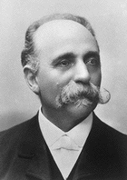
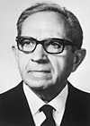
Two Major Organelles.
Endoplasmic Reticulum
&
Golgi
Two Major Concepts
-i) Where are proteins made & subsequently modified?
-ii) How are proteins directed to specific regions in cells?
Camillo Golgi
Nobel Prize 1906
Albert Claude
Nobel Prize 1974
Both of which can contribute to traffic jam

Slide 4
ER (Structure/Function)
-uninterrupted membranous tubules
& vesicles separated from cytoplasm
-RER has ribosomes on the tubules (cisterna)
-cisterna are stacked
-ER extend from nuclear membrane
13-2

Slide 5
Protein Synthesis & the RER:
-secreted & membrane proteins are sorted through RER
-sugars/carbohydrates are added to the polypeptide (glycosylation)
-proteins are folded by “chaperones”

Slide 6
Protein Synthesis in RER: What are the major players?
-i) amino terminal signal sequence of newly initiated polypeptide
-ii) Signal-Recognition Particle (SRP)
-iii) SRP receptor embedded in ER membrane
-iv) translocon: protein channel
-v) cleavage site where signal sequence is cut by a signal peptidase

Slide 7
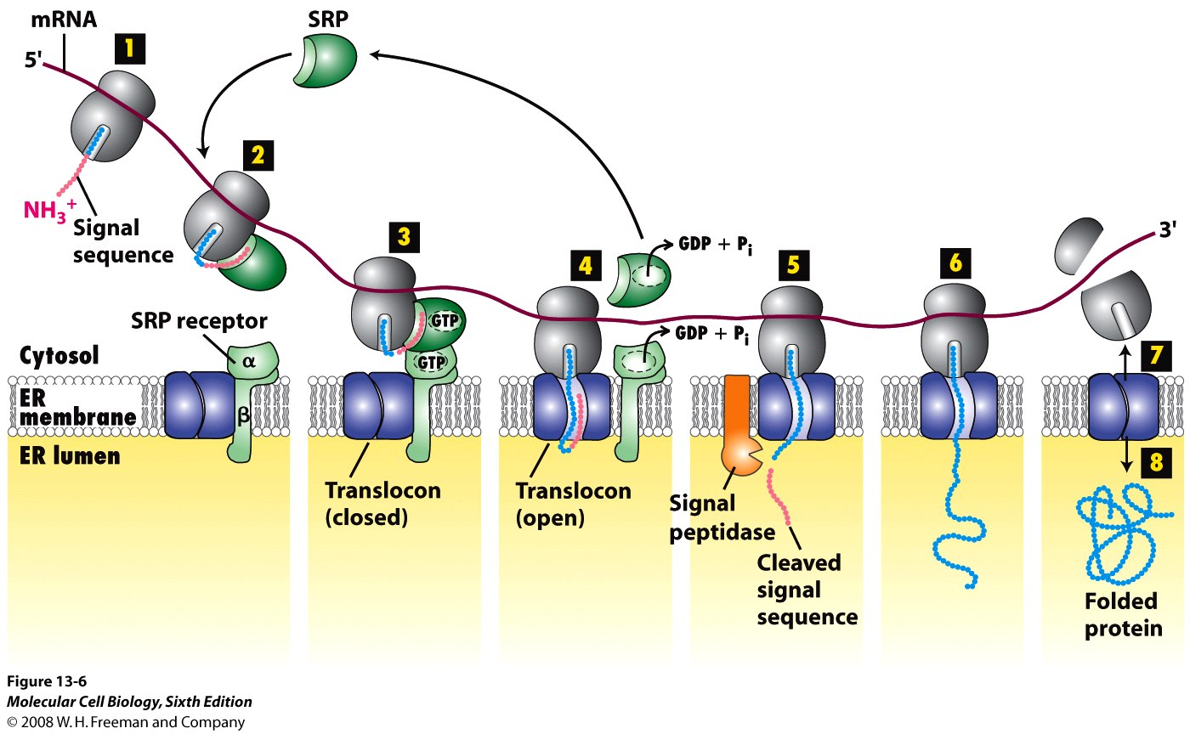
Protein synthesis: secreted proteins
Translocon Channel
Chaperones

Slide 8
Cell Free System Experiment*
In vitro translation
Add in key players one at a time

Slide 9
Cell Free System Experiment*
Insulin
3’ mRNA
5’
Signal Peptide on Translated Protein
In vitro Translation
Result: secreted protein (with signal sequence) is translated into a complete polypeptide
Complete Polypeptide
*Similar to Fig. 13-4

Slide 10
Experiment 2:
3’ mRNA
5’
Add SRP
-if SRP is added it binds signal sequence & elongation stops at 25-50 amino acids
(size of signal sequence)

Slide 11
Experiment 3
3’ mRNA
5’
SRP & SRP Receptor
Complete (nascent) Polypeptide
-adding SRP, SRP receptor & GTP leads to new elongation

Slide 12
Part 4
-add SRP, GTP & microsomes (containing a specific protease) produces a “processed polypeptide” without the 25-50 amino acids of signal sequence
Signal Peptidase

Slide 13
How can we apply this?
-- 3 sizes of polypeptides can be produced:
SS
1.
2.
3.
1.
2.
3.

Slide 14
Exam Question:
You are testing polypeptide modification during translation and have the following at your disposal: cell free system and microsomes; a 600 nucleotide mRNA (306 nucleotides of which encode for a secreted protein that has a 45 amino acid signal sequence); GTP, ³⁵S-methionine, all other amino acids and SRP receptors. Using SDS-PAGE and techniques to detect newly synthesized proteins, and assuming each amino acid has a mass of 100 daltons, which is the size of the newly translated protein?
60000
4500
5700
30600
10200
Solution:
--306 nucleotides of code for protein
--YOU have microsomes so 45aa SS is cleaved!
306 nucleotides/3 = 102aa
102-45aa = 57aa
57x 100Da = 5700 Da

Slide 15
Exam Question:
How many of the following directly relate to protein trafficking to the RER?
ampholytes; phosphatases; ubiquitin; carboxylation; SRP; fluorophores;
protein A
0
1
3
5
7

Slide 16
Stringing the Concepts Together!
-identify cells by microscopy, isolate & homogenize them to free organelles
-centrifuging homogenate allows for isolation of microsomes & ribosomes
-chromatography or (2 hybrid) is used to isolate SRP, its receptor & other proteins
-SDS-PAGE or (2D) & autoradiography is used to identify newly translated proteins

Slide 17
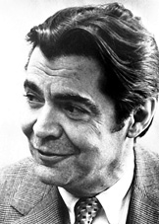
Where do proteins go after ER?
Read pages 100-01 how Pulse Chase is used to answer this question.
George Palade
1974
Read 621-22
Sumanasinc.com

Slide 18
Pulse-Chase Experiment:
Secretory cells
Pulse: radiolabelled amino acids (defined period of time)
All proteins made during that time will be labelled
Chase: unlabeled amino acids
Now all new proteins made will NOT be labelled
Fix cells at different time points and use autoradiography to visualize location of proteins in the cell
Can follow movement of one group of proteins through the cell

Slide 19
Pulse-Chase Experiment:
RER
GOLGI
PM
Sumanasinc.com

Slide 20
Golgi Complex
-consists of flattened cisterna no ribosomes
-vesicles at cisterna tips fuse or pinch off
Cartoon of Fig. 14-15
Trans Golgi Network
Types of Cisternae:
i) trans-opposite RER
ii) medial
iii) cis- faces RER
Cis Golgi Network

Slide 21
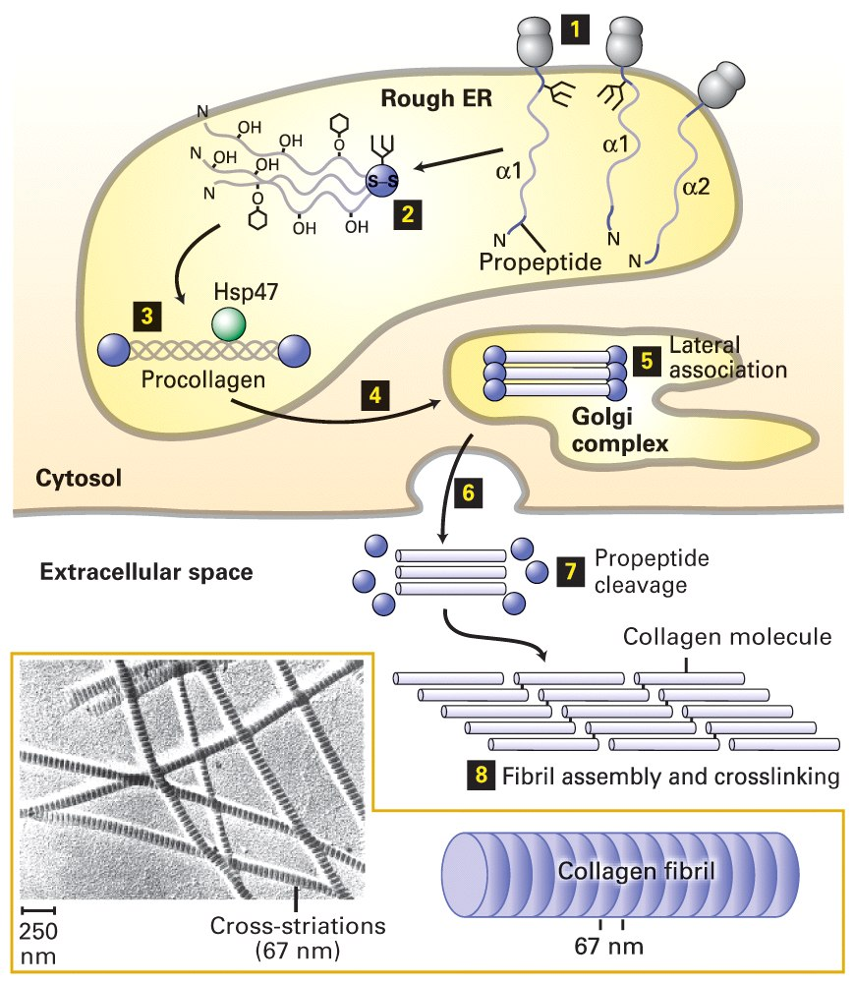
Golgi Function: - “Scurvy”
-sugars are trimmed from polypeptide
-hydroxyl groups, added in RER, are used for folding
-final synthesis/packaging for secretion
Proline + Lysine
Vitamin C
Fig. 19-24
Chaperone

Slide 22
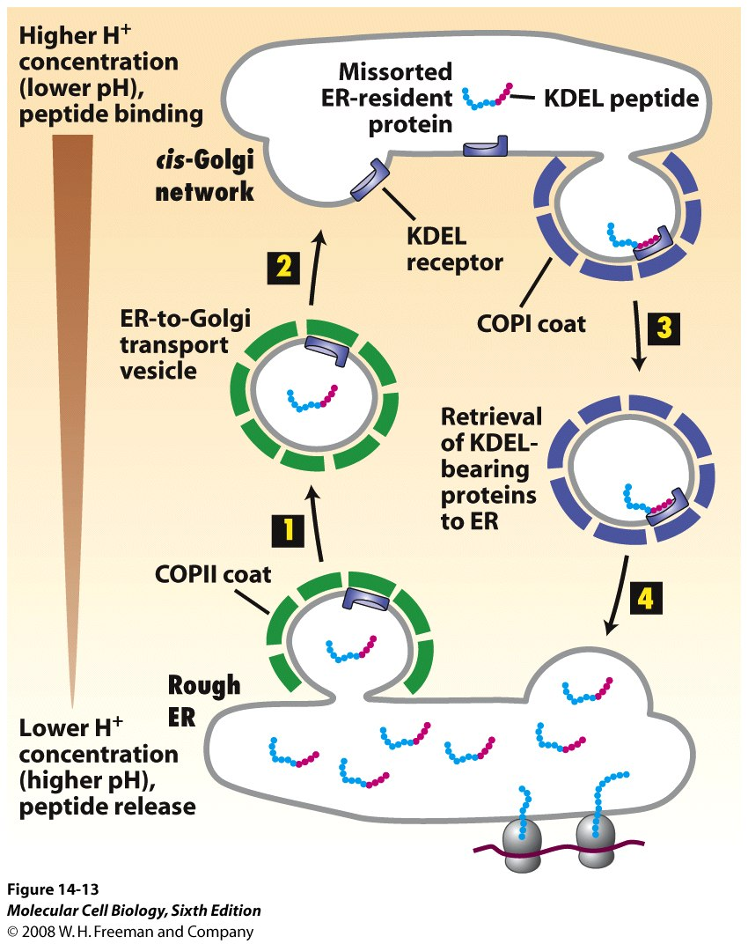
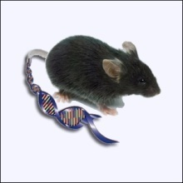
Golgi also reroutes proteins back to RER
or lysosomes (protein trafficking)
How?
-KDEL signal on proteins that should stay in RER lumen
“Retention Signal”
retrograde
anterograde
coatamers
14-13

Slide 23
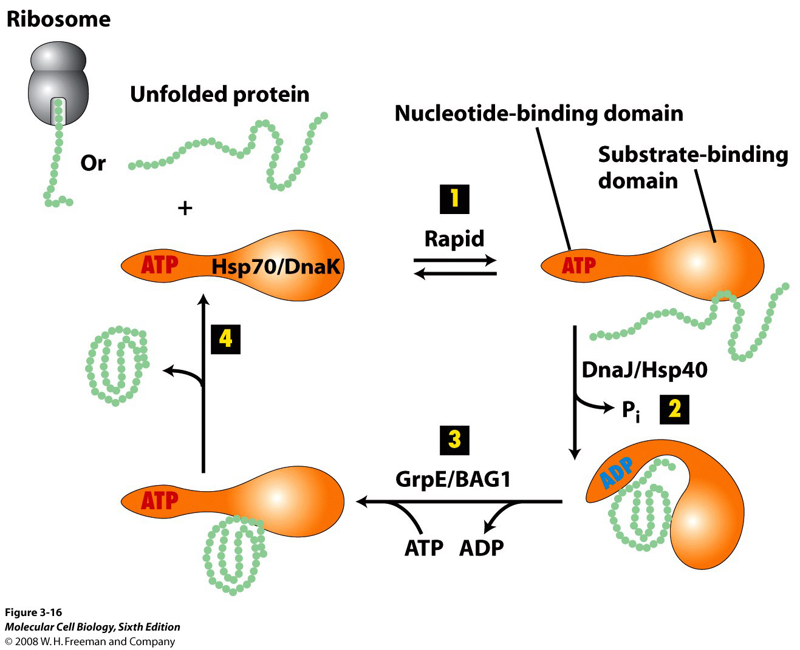
Proteins That Use Retention Signals.
Chaperones - lumen proteins
Hsc70
Fig. 3-16
-a chaperone should remain in ER but will shuttle to Golgi
-if it happens a KDEL receptor picks up the chaperone & returns it to RER

Slide 24
Other Signals: Mannose-6-Phosphate
-M6P targets proteins to lysosome
-lysosomal enzymes degrade:
nucleotides, proteins & lipids
-targeting requires a M6P receptor
-enzymes having M6P bind receptor
Sugar
in cis Golgi!
Fig. 14-21

Slide 25
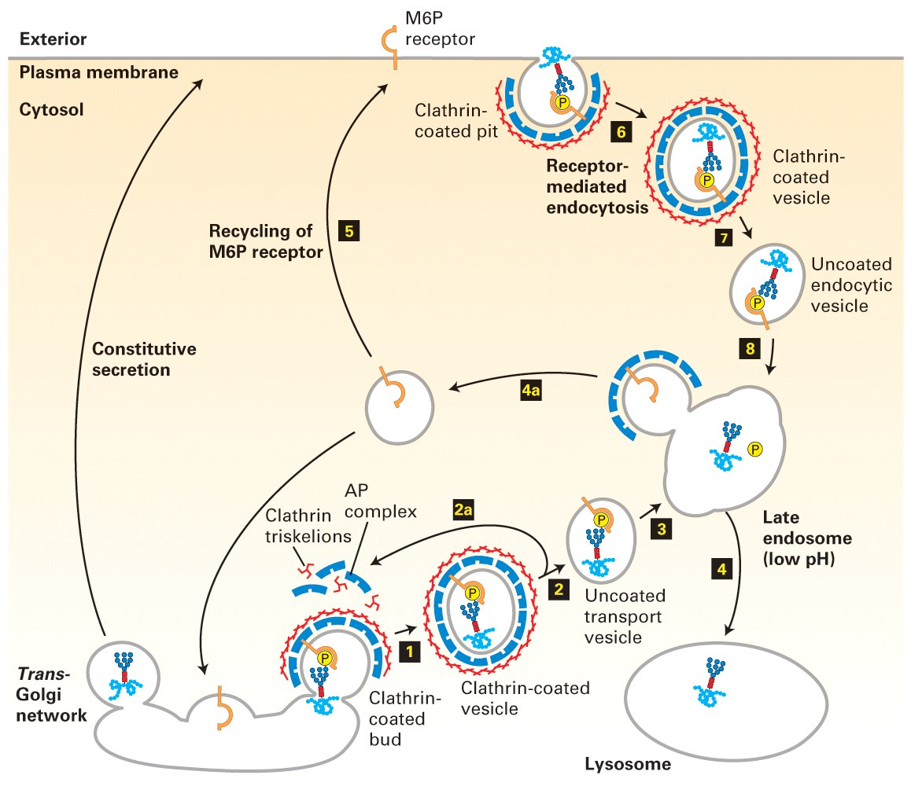
Fig. 14-22
AP=adapter proteins
CURL
CIS
-receptor binding occurs ~ pH 7 (Golgi)
-at low pH M6P detaches from receptor (CURL)
-M6P receptors return to Golgi or to PM

Slide 26
Exam Question:
During translation, carbohydrates and sugars are added to proteins that are
secreted or placed on the cell surface. Which of the following is likely to be
the correct transport route of a protein that sits on the surface of your red
blood cells?
Ribosome, ER, trans-Golgi, medial-Golgi, placement in the plasma membrane
ER, trans-Golgi, cis-Golgi, lysosome, placement in the plasma membrane
Cis-Golgi, trans-Golgi, proteasome, placement in the plasma membrane
ER, cis-Golgi, medial-Golgi, trans-Golgi, placement in the plasma membrane
Ribosome, ER, medial-Golgi, peroxisome, placement in the plasma membrane

Slide 27
Exam Question:
Growth hormone (GH) plays a major role in our body, yet blocking the polypeptide’s
entrance into the bloodstream would have frightful consequences. If an individual’s
pituitary cells were unable to _______________________ it would severely hinder
his/her’s ability to make a secretable form of GH and thus they would likely suffer
from growth retardation or dwarfism.
Synthesize SRP
Raise the pH in the CURL
Phosphorylate KDEL
Methylate MPF
Target clathrin to a proteasome

Slide 28
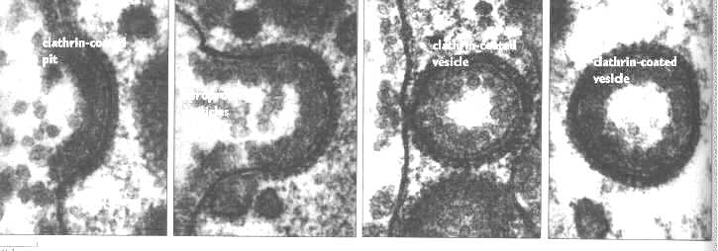
Receptor Mediated Endocytosis:
What is it??
-a method of SELECTIVE internalization
-Ex: LDL internalization

Slide 29
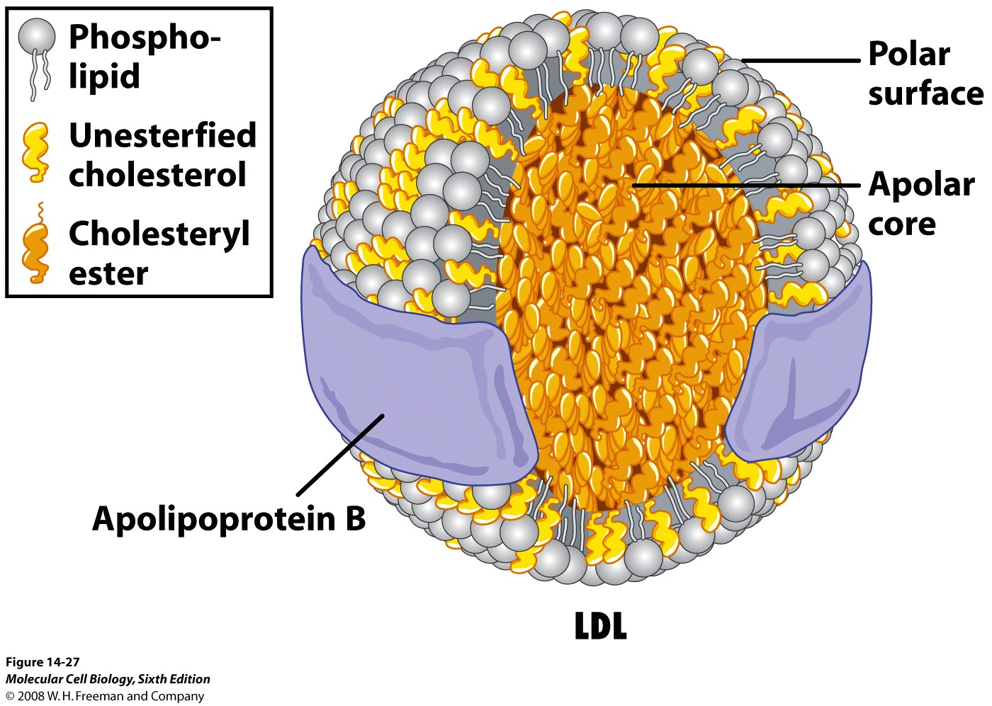
How is cholesterol internalized?
-LDL receptors on plasma membrane
-clathrin in cytoplasm to bind receptor’s C-terminus
-ApoB, a water soluble carrier of cholesterol
LDL Particle
14-27

Slide 30
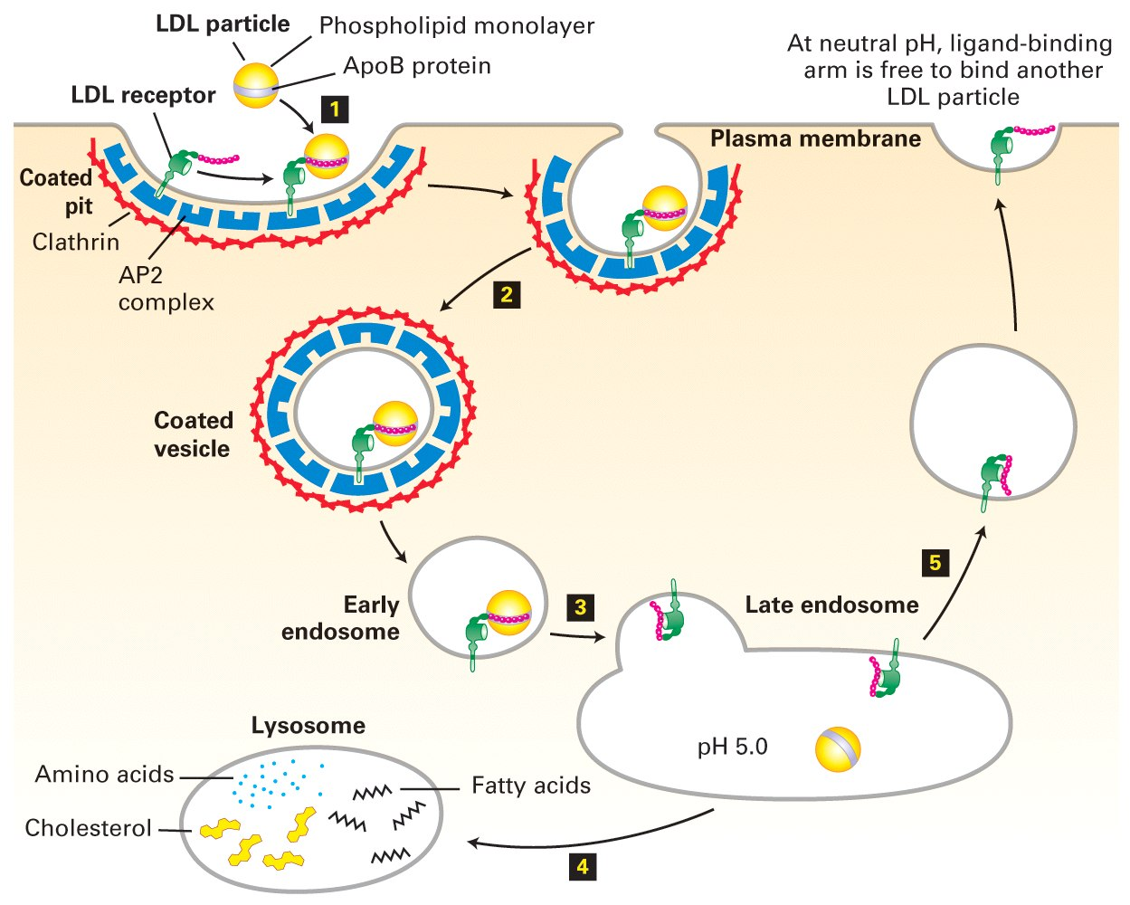
Receptor-Mediated Endocytosis
The Concept: What is it?
A method of selective internalization
CURL
Fig. 14-29

Slide 31
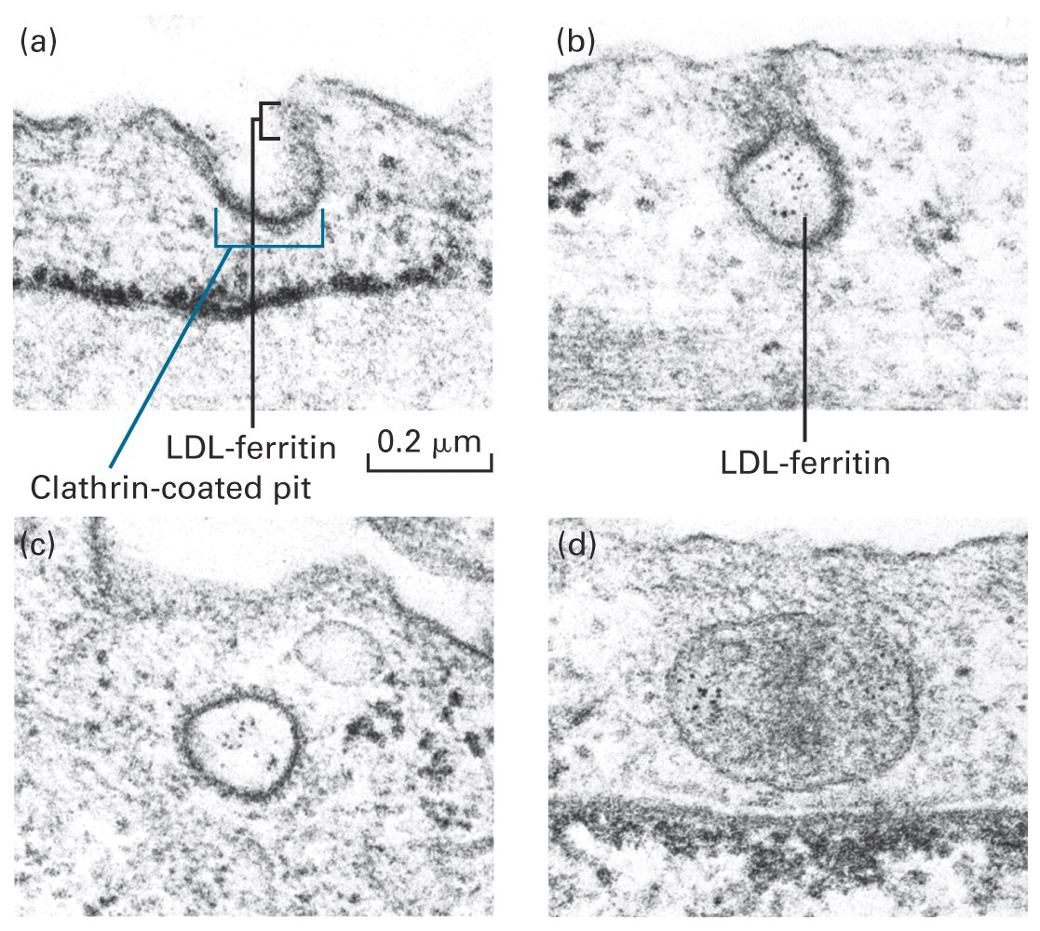
e.g. LDL (low density lipoprotein)
-receptors in plasma membrane recognizes a unique ligand (LDL)
-clathrin helps internalize ligand
Fig. 14-26

Slide 32
How do the players work?
-cholesterol, insoluble in body fluids, is transported by ApoB
-LDL receptors bind ApoB
& internalize particles
-internalization depends
on clathrin
-clathrin coat dissociates inside, vesicle goes to lysosome & ApoB is degraded
-receptors shuttle back to plasma membrane or are degraded in lysosome
Triskelion

Slide 33
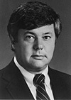
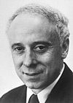
Why internalize LDL?
-high cholesterol levels in blood Hypercholesterolemia
Reasons: no LDL receptor; receptor binds LDL poorly; receptor can’t internalize LDL
Prognosis: heart attack & stroke
Nobel 1985
Artery
Plaque
M. Brown
J. Goldstein
statins

Slide 34
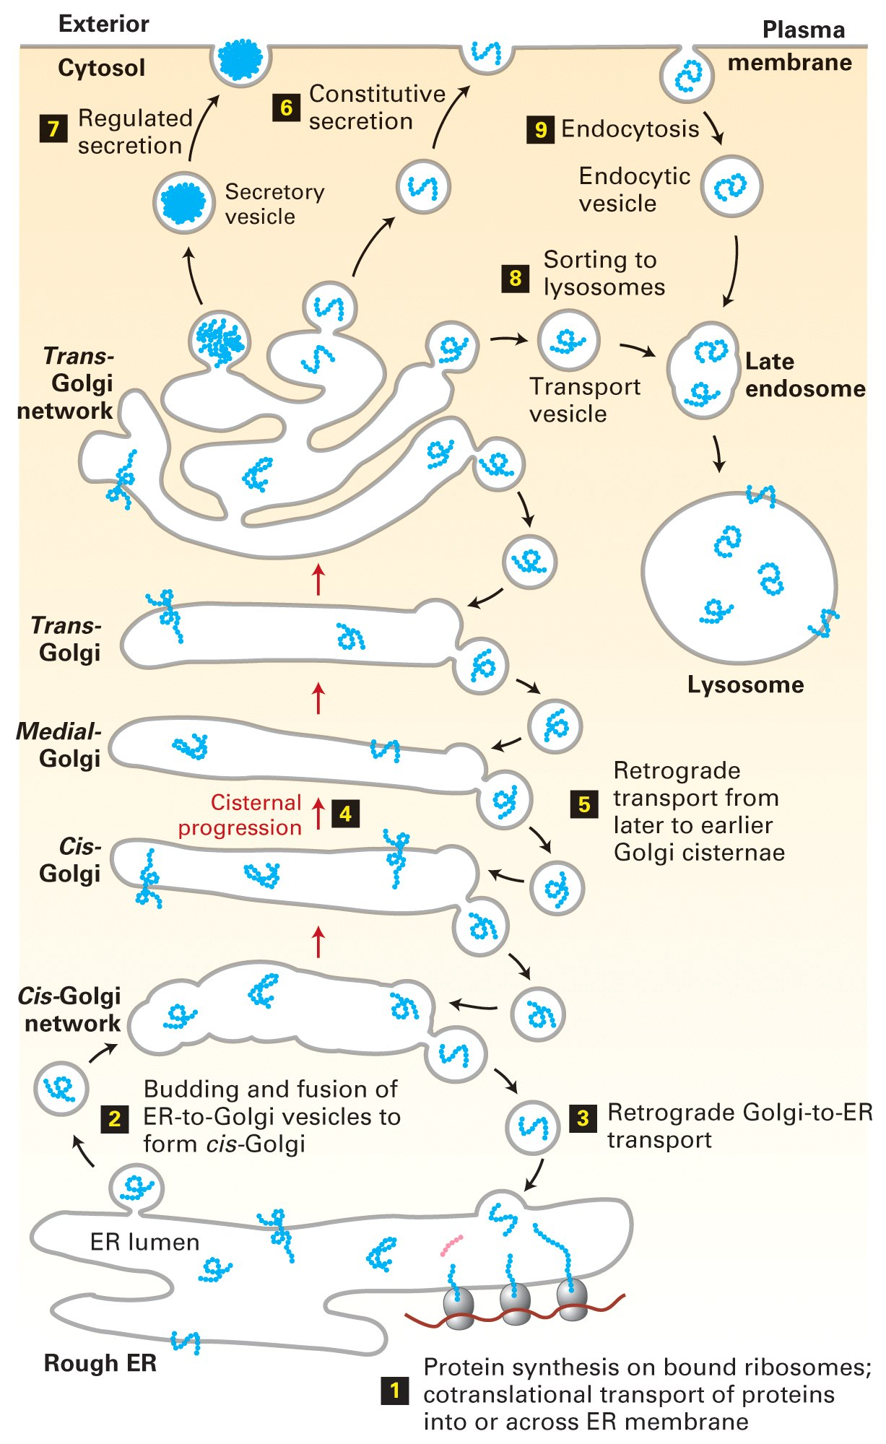
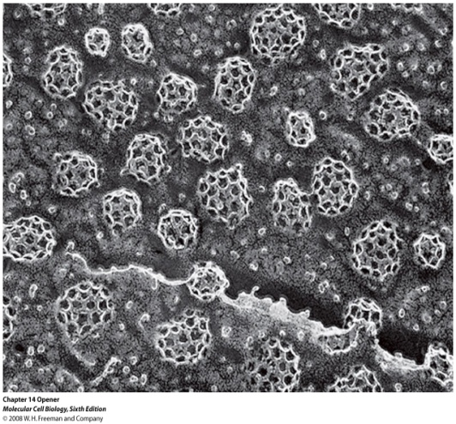
Clathrin
Conceptual Recap
Go over Fig. 14-1 on Protein Secretion
Notes:
-constitutive vs regulated secretion
--constitutive= cells constantly secrete proteins regarldless of environmental signal (fibroblasts secreting collagen)
--regulated= cells secrete protiens in response to environmental stimulus (pancreatic beta cells secrete insulin in response to sugar)
----protien waits in vesicles at cell surface until signal

Slide 35
Exam Question:
A CURL is a type of organelle that plays a fundamental role in:
ligand-specific phagocytosis
Prokaryotic cell cycle regulation
Protein transcription
Receptor mediated endocytosis
None of the above

Slide 36
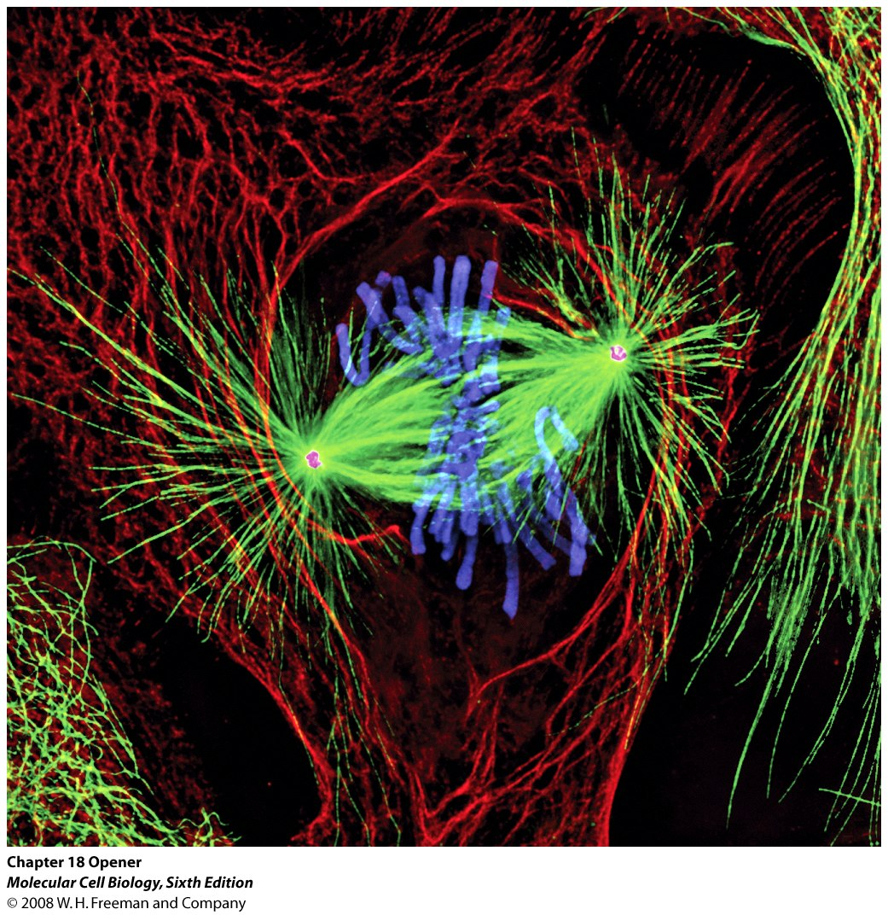
MITOSIS & CELL CYCLE CONTROL pages 781-783, Chapter 20
Fig. 20-11

Slide 37
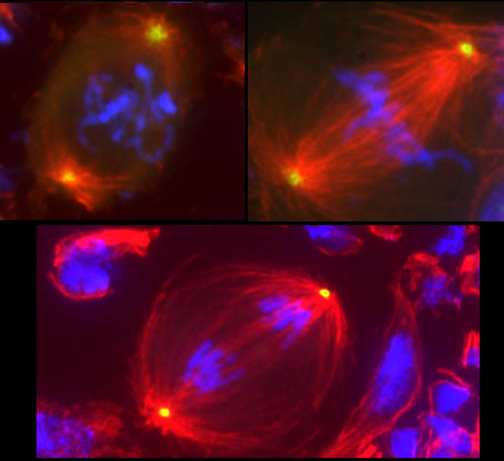
Concept:
-cell proliferation depends on signals
-progression through cell cycle is regulated
-check points ensure things should proceed:
Is all DNA replicated?
Is cell big enough?
Is environment favorable?
Is DNA damaged?

Slide 38
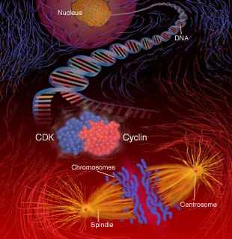
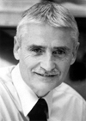
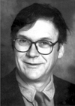
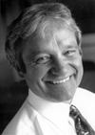
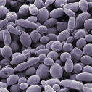
Yet Another Nobel Story
Hartwell, Hunt & Nurse, 2001
yeast
-involves 3 protein families,
2 of which are enzymes
i) Kinases ii) Phosphatases iii) Cyclins

Slide 39
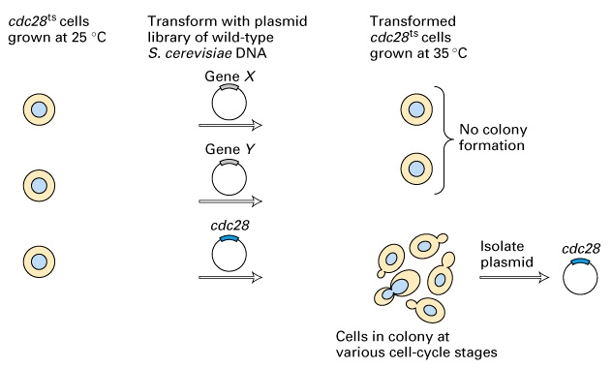
Regulation of Cell Cycle
Yeast Mutations & Phenotypes
Mutated
S. pombe
Cdc2 ts
Transform with plasmid library of wild-type S. Pombe DNA
Transformed Cdc2 ts
Cdc2
Cdc2
complementation
Modified from Fig. 20-4
I am going to use Cdc2 in place of 28

Slide 40
CDC’s: The players:
-mutating cdc2 gene prevents S.pombe from entering G₂-M
-cdc2 is transcribed & translated throughout cell cycle
-cdc2 encodes a protein kinase (p34^{cdc2}) in all eukaryotes
Fig. 20-11
20-12

Slide 41
Player 2
-p34^{cdc2}: cyclin dependent kinase (cdk)
-cyclin is encoded by cdc13 gene
-p34^{cdc2} + cyclin make MPF
(mitosis promoting factor)
-p34^{cdc2} in MPF is inactive for most of cell cycle
p34 activity
p34 amount
G1
S
G2
M

Slide 42
Experiment to explain changes:
- label sea urchin eggs with ³⁵S-met.
- isolate newly-translated proteins at time points
- analyze by SDS-PAGE & expose gel to X-ray film

Slide 43
Proving it Experimentally
Samples
Autoradiography
1
2
3
4
5
6
7
8
p34
cyclin
Cell Cycle
G1
S
G2
M
G1
S
G2
M
Conclusions:
-bands are consistent but some appear greater at one point in cell cycle, disappear & reappear at same point next cycle
Cyclin is responsible!

Slide 44
Cyclin levels increase during cycle
MPF
cyclin
p34 activity
p34 amount
G1
S
G2
M
-p34^{cdc2} levels are equivalent during cell cycle but “its activity” fluctuates
- at late G2 p34 kinase binds cyclin to form & activate MPF

Slide 45
-MPF (p34^{cdc2}) activity is low in S phase, peaks as M begins, & drops off suddenly only to repeat process. How?
Inhibitory kinase
20-14
Activating kinase

Slide 46
How does cell control kinase activity of MPF?
-cdc25 encodes a phosphatase to activate p34^{cdc2}
-activating p34^{cdc2} in MPF drives G₂-M transition
Fig.20-14
What will the cell do with active MPF?

Slide 47
How does a Kinase promote mitosis?

Slide 48
How does phosphorylation (PO₄’n) influence cell cycle?
-histone H1 PO₄’n causes chromosome condensation - prophase
-MAP PO₄’n promotes microtubule disassembly
-RNA polymerase is inactivated
-Golgi, RER membrane, nuclear pore protein PO₄’n aid organelle rupture
in general terms

Slide 49
What kicks cell out of mitosis?
-cyclin contains destruction box of 4 amino acids
-cyclin destructs at Anaphase
Take home message - motif of 4 amino acids R-x-x-L
Notes:
-arginine-any aa-any aa-leucine

Slide 50
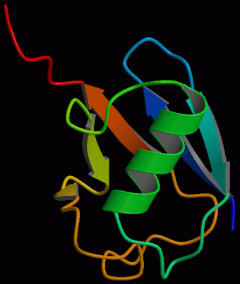
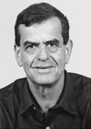
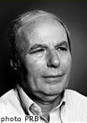
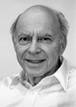
Another Nobel?
Ciechanover
Hershko
Rose
Chemistry 2004
Ubiquitin

Slide 51
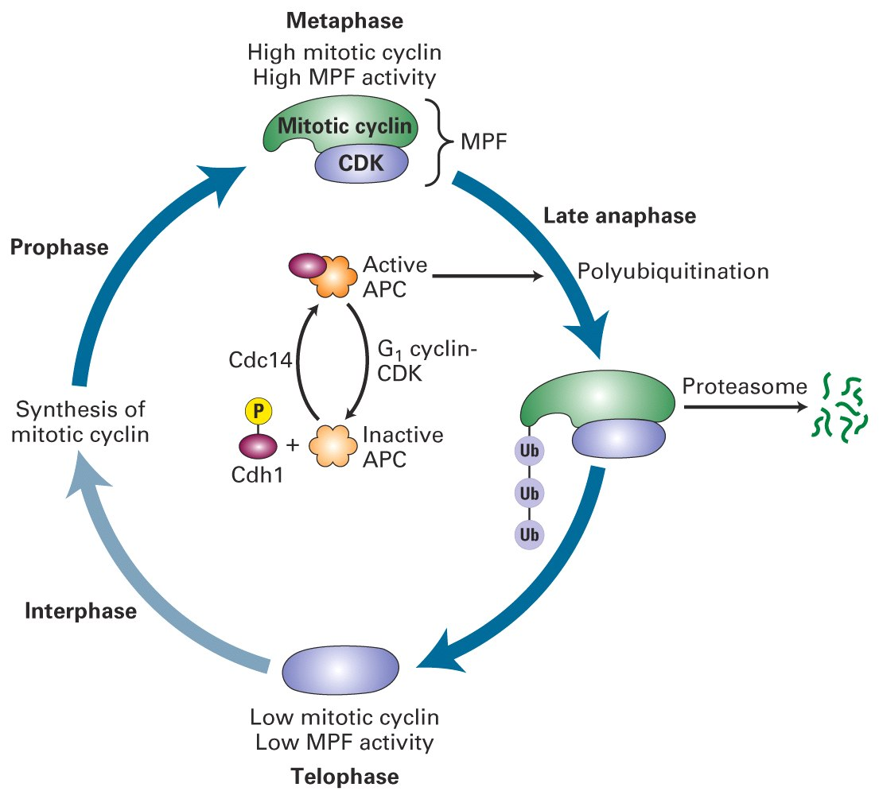
“Need to Know” box
-proteins bind to box causing “ubiquitin” to bind cyclin
-ubiquitin targets cyclin’s destruction via proteases in a
“proteasome complex”
-the cell soon returns to Interphase
Ubiquitin ligase
Modified Fig. 20-10

Slide 52
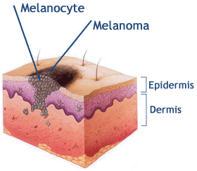
BUT when things go wrong!
-DNA damage stabilizes p53
-p53 transcribes the p21 gene
-p21 (cdk inhibitor) binds MPF
& halts cell cycle
-DNA is repaired or cell undergoes Apoptosis - hopefully
Simplified (very) Fig. 20-35
Mutated in cancers!
DNA damage checkpoint
EXAM QUESTION!!!

Slide 53
Exam Question:
You are studying yeast cell cycle regulation, and you mutate the CAK gene so
that it no longer produces functional protein. Which phenotype would you
expect to see resulting from this mutation?
Wild-type sized yeast that grow normally
Yeast cells that continue growing but do not divide and eventually die
Yeast cells that divide prematurely and eventually die
Wild-type sized yeast cells that grow in HAT media
None of the above

Slide 54
Exam Question:
NF-κB is a master transcriptional regulator of our immune system. Normally, it
is kept in an inactive state by an intracellular inhibitor called I-κBα. During an
immune response, I-κBα is phosphorylated and poly-ubiquitinated causing its
release from NF-κB, which enters the nucleus and transcribes a number of
essential genes. The modified I-κBα would be found in the:
Trans-Golgi
RER
Nuclear pore
Proteasome
Medial-Golgi

Slide 55
Good Luck!!!

